Slide 1
NODE.JS
(The Backend Of MERN Stack)
Lecture 35

Slide 2
Today’s Agenda
Node-MongoDB Connection
About MongoDB driver
About Mongoose
Benefits Of Mongoose
Connecting Using Mongoose
Examples

Slide 3
Node-mongodb connection
There are 2 ways to connect a Node application to MongoDB database:
Using MongoDB native driver called MongoClient
Using an ODM tool called Mongoose

Slide 4
About mongodb driver
The MongoDB native driver for Node.JS is a dependency that allows our Node/Express applications to interact with the MongoDB database, either locally or on the cloud through MongoDB Atlas.
We are allowed to use promises as well as callbacks that gives us greater flexibility in using ES6 features.

Slide 5
About mongoose
Mongoose is a promise based Object Data Modeling (ODM) library built for Node.js projects on top of MongoDB driver.
It maps the MongoDB documents to JS objects, thus enabling our NodeJS program to operate the connected MongoDB databases.

Slide 6
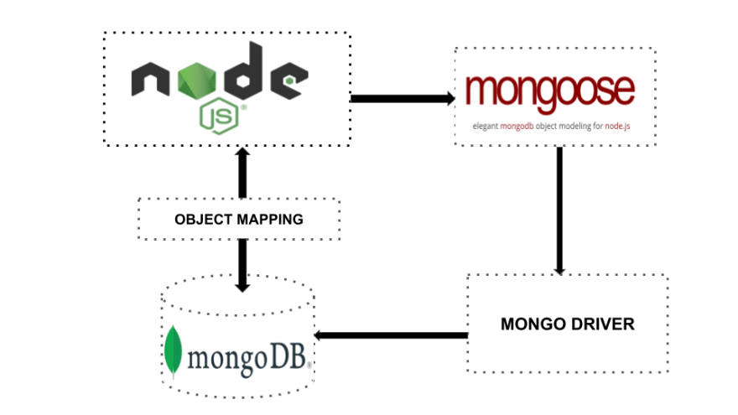
About mongoose
Just like Express provides an abstraction layer over Node , similarly Mongoose provides an abstraction layer for MongoDB.

Slide 7
About mongoose
In other words we can say that Mongoose simplifies how we interact with a MongoDB database.
It lets us save time on writing MongoDB validation, casting, and business logic boilerplate.
However the main benefit of Mongoose, is Schema validation at the application layer.

Slide 8
What is schema validation ?
MongoDB is famous for being schema-free which means that one collection can accept different kinds of documents, thus giving us lots of flexibility.
But this raises a concern that junk/irrelevant data can also be inserted into a collection.
To ensure this does not happen we can apply schema validation

Slide 9
What is schema?
The schema in a database is equivalent to a class in object-oriented programming.
It is like a blueprint for the objects that are stored in the database.

Slide 10
What is schema?
The schema has details about the various properties that an object will contain.
These details includes the name and type the type of those properties (String, Number, etc.), and if required what conditions will be followed by the value of the property.

Slide 11
What is schema?
For example, a property may be specified to have a unique value.
Hence we can say that mongoose adds a layer of validation above MongoDB.

Slide 12
What is model?
A Mongoose model is the compiled version of the schema and maps directly to a single document in a MongoDB collection.
In simple words a model is like a constructor using which we can create objects to represent a MongDB document .

Slide 13
What is model?
The schema is used to define models, and every object that has database operations performed on it must reference some model.
Mongoose models are responsible for querying, creating, updating, and removing the documents from the MongoDB database.

Slide 14
Benefits of mongoose
Schema: Sets the overall structure and how the data is organized in the database which helps in controlling junk data.
Built-in validation: This means we don’t have to write the extra code for data validation by simply including things like required:true in our schema definitions, the Mongoose library will provide in-house validations for our collections (including data types).

Slide 15
Benefits of mongoose
Returning Results : The updated documents and the query results can be easily returned with Mongoose.
For example in MongoDB, an update query only returns an object with a success flag and the number of documents modified. Mongoose, on the other hand, provides us the updated document itself so we can easily process the results.

Slide 16
Installing mongoose
Before we can use Mongoose in our Node applications , we need to install it , which is done as follows:
npm install mongoose

Slide 17
Connecting to mongodb
In order to connect the MongoDB database to our Node application , we need to follow 2 simple steps.
Import the mongoose package.
Establish the connection to MongoDB database.

Slide 18
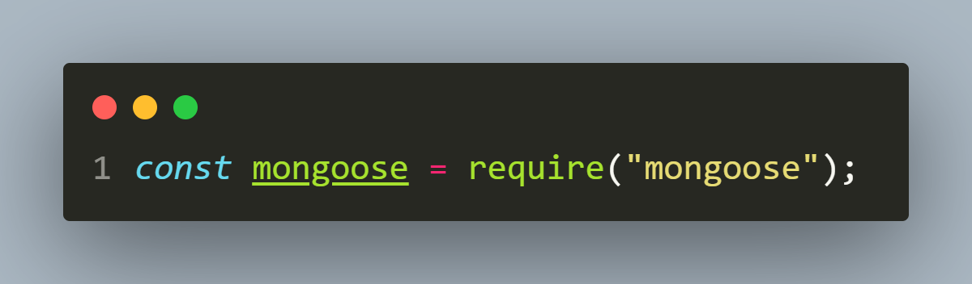
Step 1- import mongoose
The first step is to load the mongoose package using the require() function.
The above call will return an object which provides methods to interact with MongoDB database.

Slide 19
Step 2- establish the connection
The next step is to connect our application to the MongoDB database.
This is done by calling the method connect() of mongoose object.

Slide 20

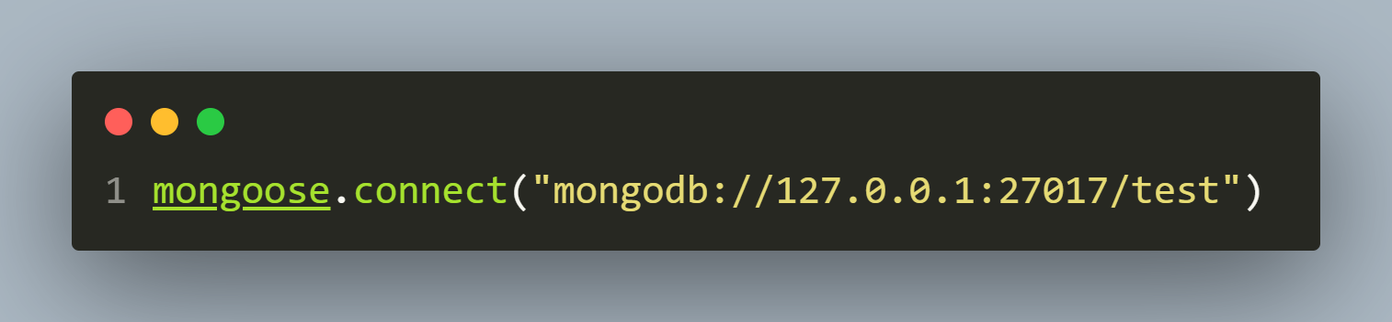
Step 2- establish the connection
Following is the syntax of connect():
url: It is a string of the following format: “mongodb://<hostName>:<mongo_port>:<db_name>”
Example:

Slide 21
Step 2- establish the connection
Element | Explanation
mongodb:// | This is the protocol that indicates the type of database being connected to
127.0.0.1 | It refers to the hostname or IP address of the server where the MongoDB database is running. In this case, it indicates that the database is on the local machine.
27017 | This is the port number on which the MongoDB server is listening for incoming connections. The default port for MongoDB is 27017
test | It specifies the name of the MongoDB database to connect to

Slide 22
Step 2- establish the connection
options: It is an object containing connection options.
Key | Explanation
useNewUrlParser | It is used to parse the MongoDB connection string using the new URL parser. Set it to true to enable this feature.
useUnifiedTopology | This option enables the new MongoDB driver's unified topology engine for managing connections. Set it to true to use the new engine.
poolSize | It sets the maximum number of sockets that can be opened for the MongoDB connection

Slide 23
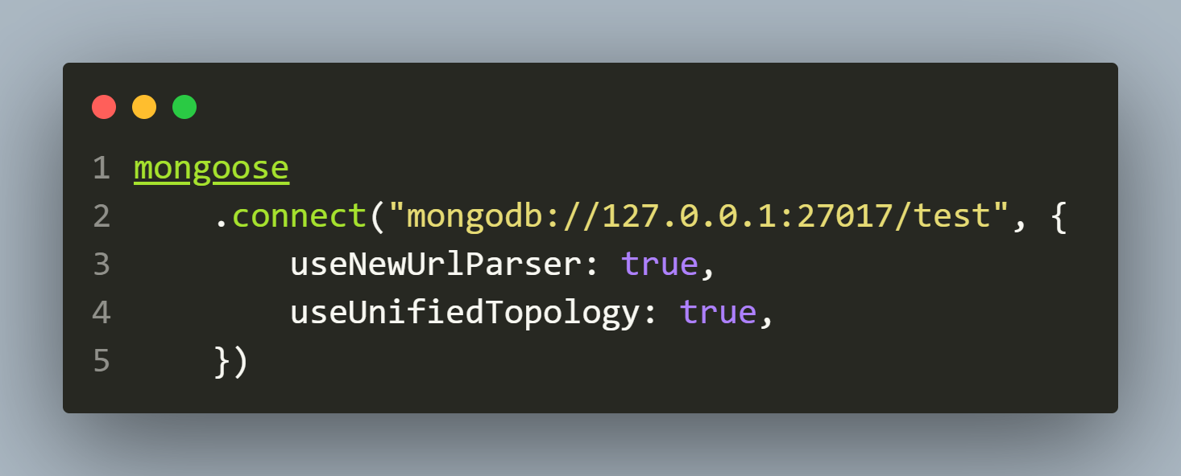
Sample call with both parameters

Slide 24
Getting status of connection
The connect() method returns a Promise.
So in order to know if the connection was successful or not we have 2 options:
Set up a then() and catch() handler.
Use try-catch with async/await.

Slide 25
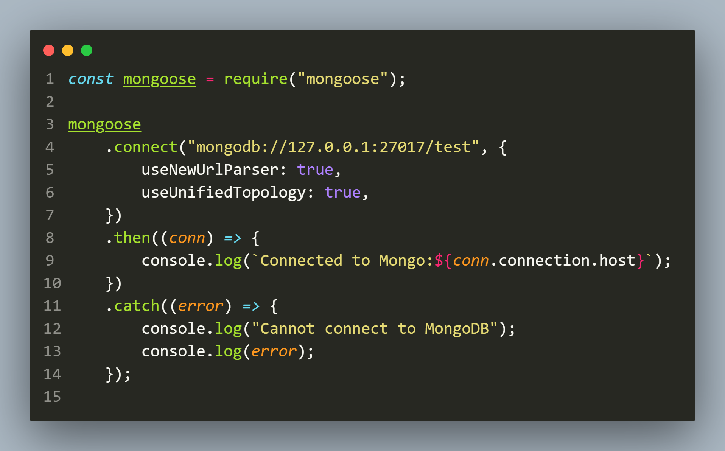
Using then() and catch()

Slide 26
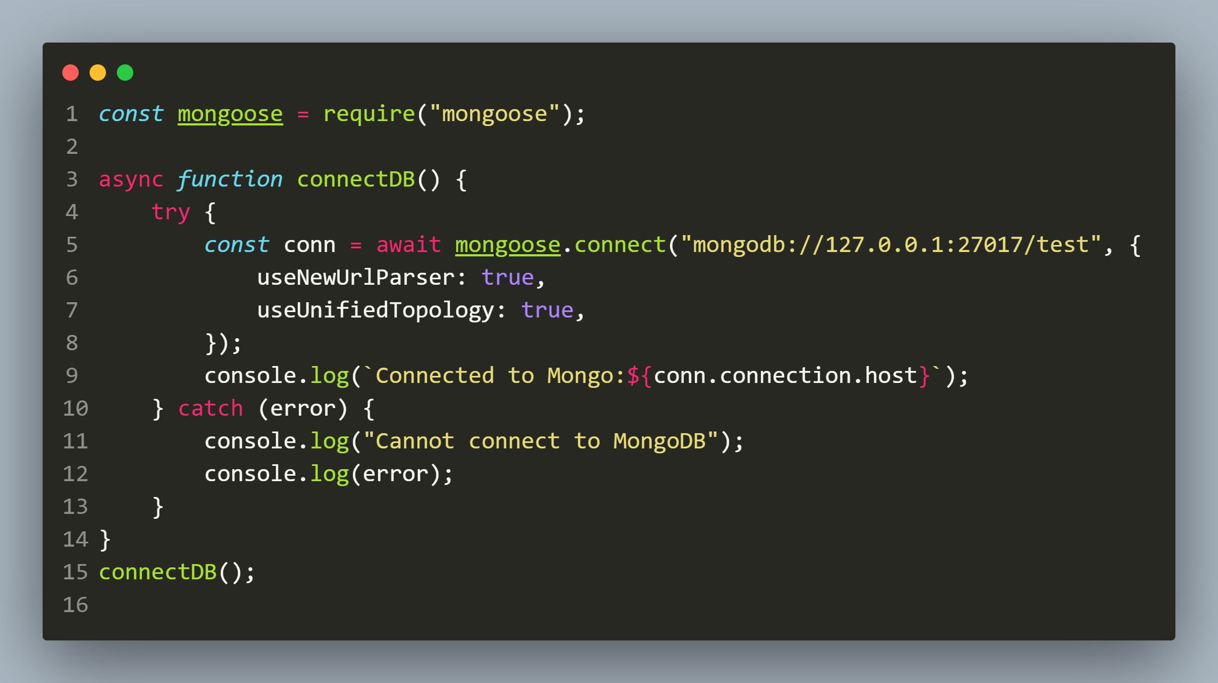
Using async/await

